Slide 1

PICK AND PLACE POLAR MACHINE(PPPM)
BATCH NUMBER : 07
PRESENTED BY
UVANRAJ K (99007995)
HEMANDH N (99007996)
VISHAL FRED (99007997)
MALATESH HAVANUR (990077998)
KOUSHIK KULKARNI (99007946)
ANANT BAGALKOT (99007947)

Slide 2
PROBLEM STATEMENT
It is required to design a pick and place system in an automated processing line for picking the workpiece from a specified location and place it in position located at same radius and 90 degrees rotation in anticlockwise sense looking from the top. The system is to wait in this position for 10 seconds to allow for the process to complete and again pick up the component, rotate by further 90 degree anticlockwise (180 degrees with respect to first pick-up location) and place the workpiece at radial extension of 15 mm for further transfer. The system then rotates back to the home position and waits for the next workpiece to arrive at first pick up location. The weight carrying capacity of the system should be minimum 3 kg. A vertical displacement of 80 mm, radial displacement of 100 mm and rotation of 180 degrees is required for the system to function.
You are required to design the mechanism for picking the workpiece from the pick up location, transfer it to the processing station, wait for 10 seconds, pick it up again and transfer it to the next location. The design should clearly provide the mechanism implemented, design calculations for strength/dimensions for each link/component and justify selection of any off-the-shelf component like bolts, bearings, bushes, motors, couplings etc. You can select the gripper/end effecter of your choice but you need to clearly specify its features and limitations.

Slide 3
SOFTWARE USED
Creo parametric 7.0 is used to design the CAD model of Pick and Place Polar Machine

Slide 4
MATERIAL SELECTION
Aluminium 2024 T4 is the material used to design the Machine.
Because the major force acts on the base plate are compressive force due to the load and the shear force due to the friction.
The selected material has higher compressive and shear strength and the main advantage are less weight and low cost.
PROPERTIES AND ITS COMPOSITION
http://asm.matweb.com/search/SpecificMaterial.asp?bassnum=ma2024t4

Slide 5
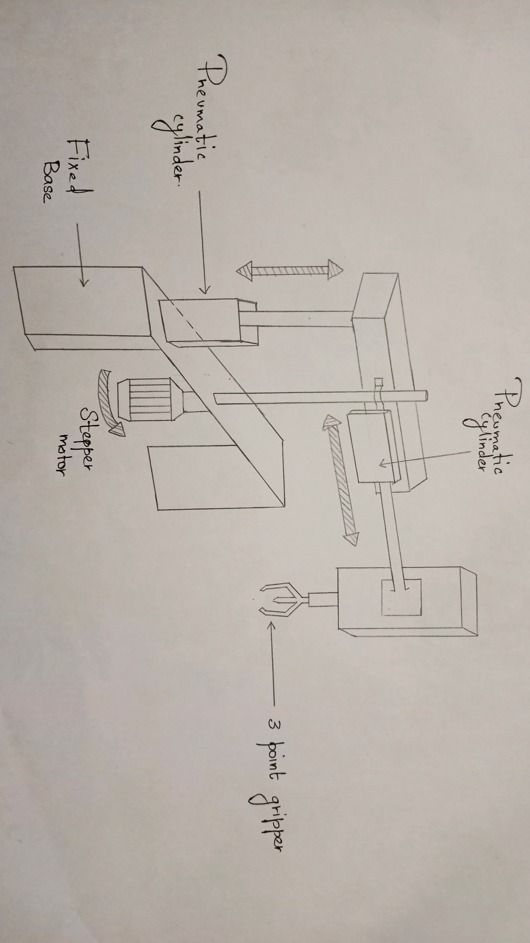
BASIC DESIGN

Slide 6
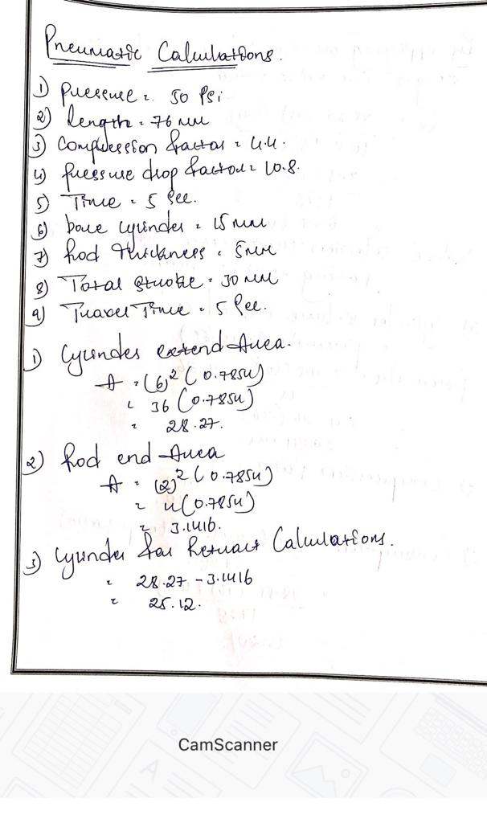
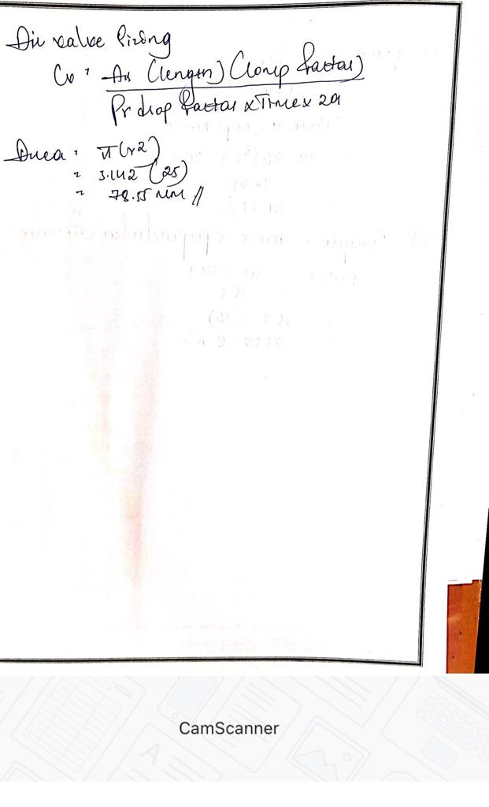
DESIGN CALCULATIONS

Slide 7
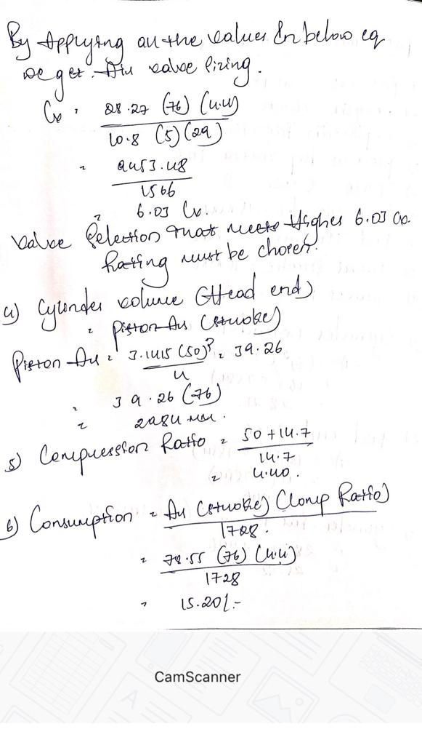
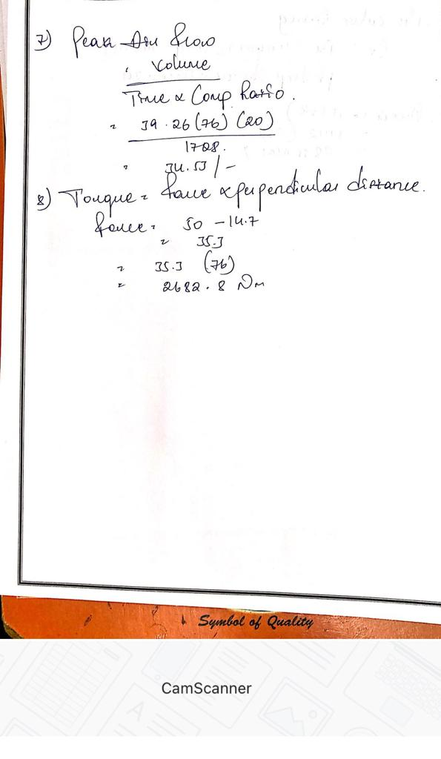
DESIGN CALCULATIONS

Slide 8
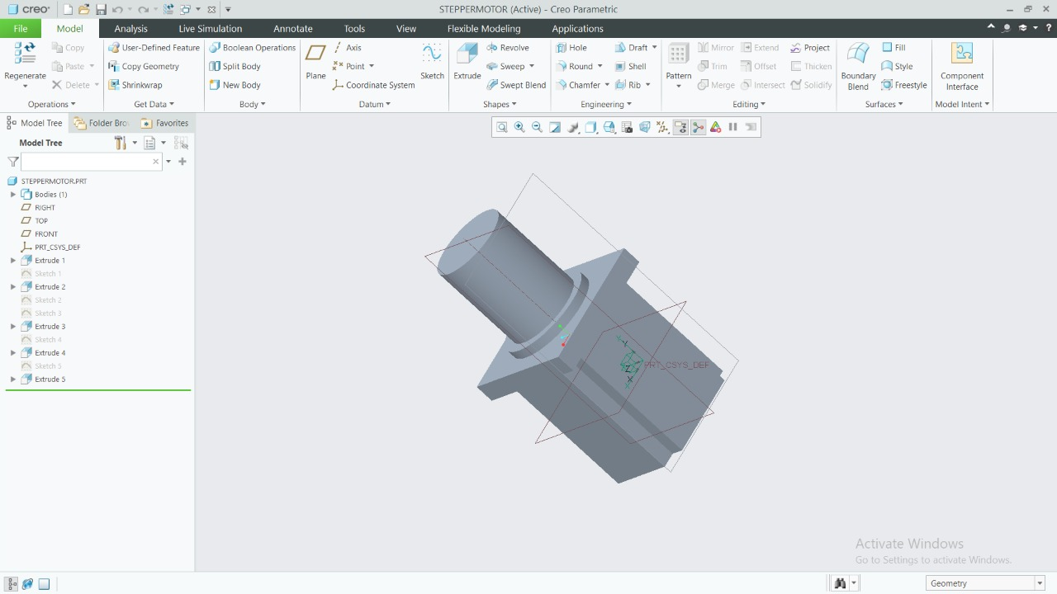
3D DESIGN
STEPPER MOTOR

Slide 9
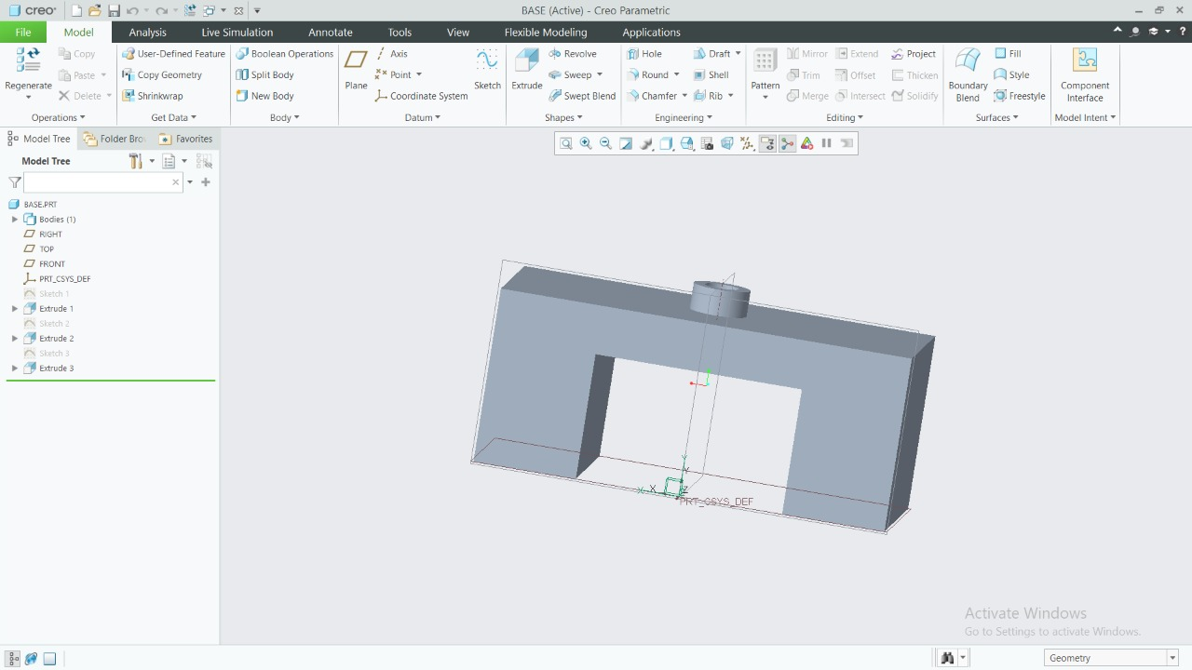
3D DESIGN
BASE

Slide 10
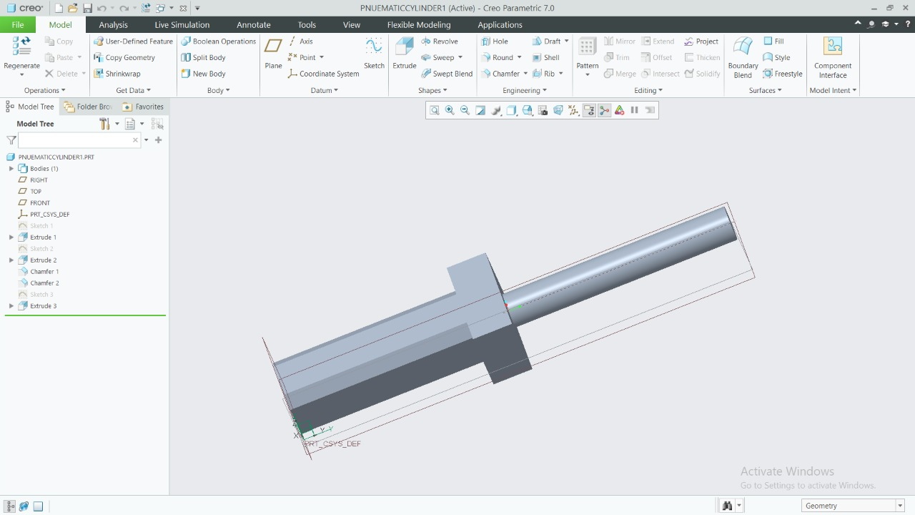
3D DESIGN
PNEUMATIC CYLINDER

Slide 11
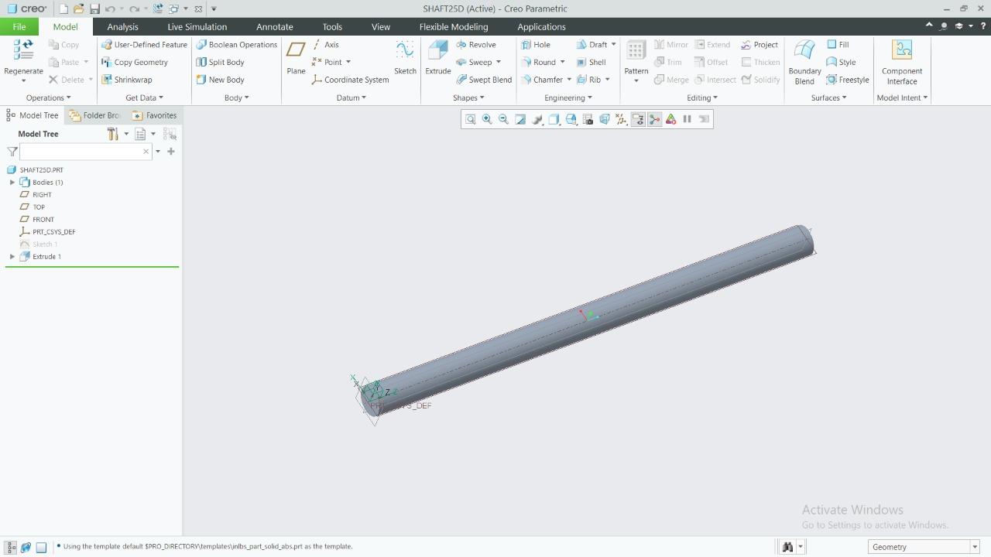
3D DESIGN
MAIN SHAFT

Slide 12
THANKYOU

